Slide 1
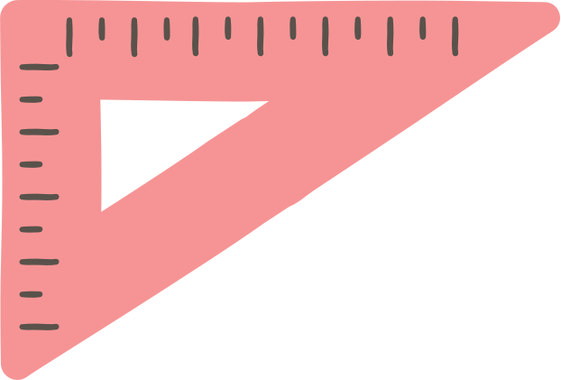

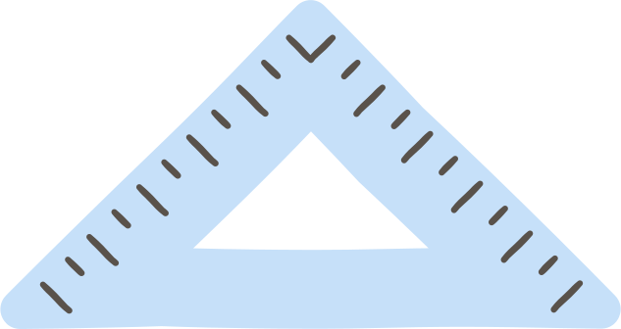

TEMPLATES IN EDUCATIONAL ACTIVITIES

Slide 2
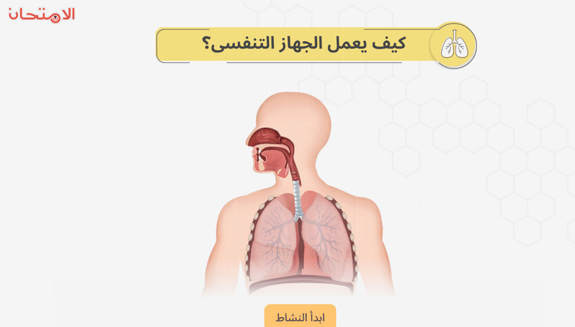
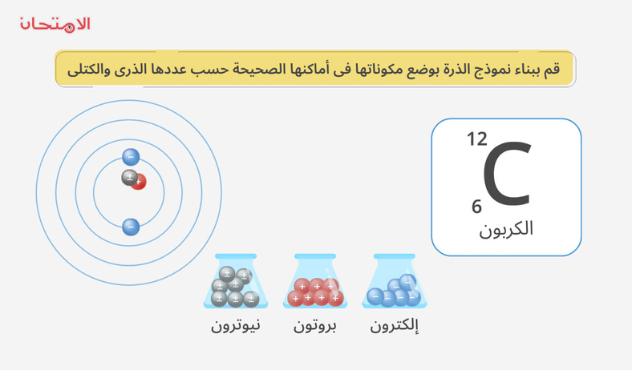
1: INTRODUCTION
Current Workflow Process
Idea → Discussion → Storyboard → Design
Handoff to development team for implementation
2+ review cycles before final product delivery

Slide 3
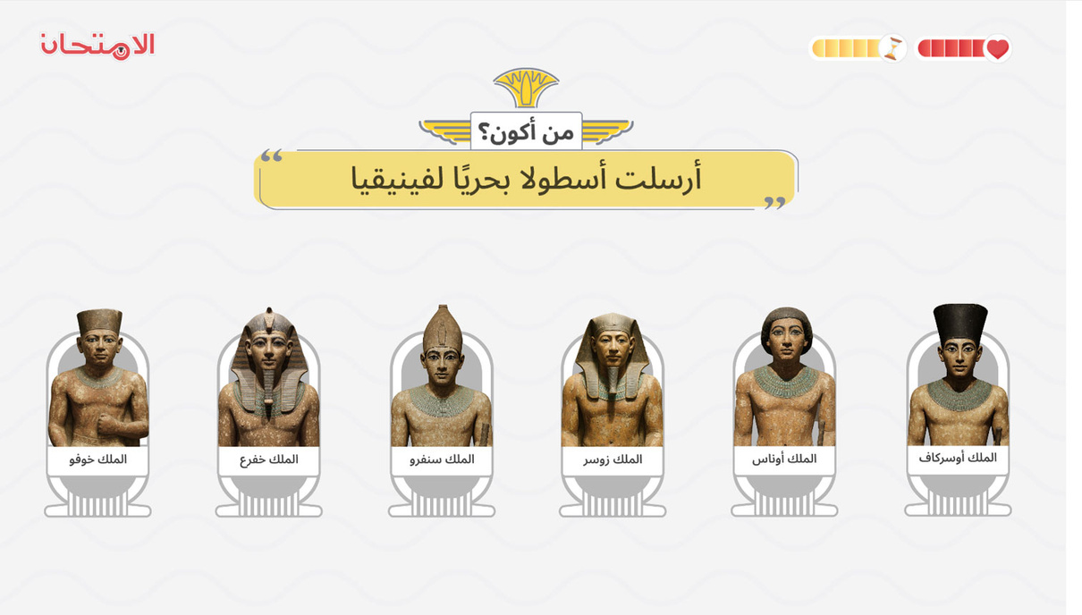
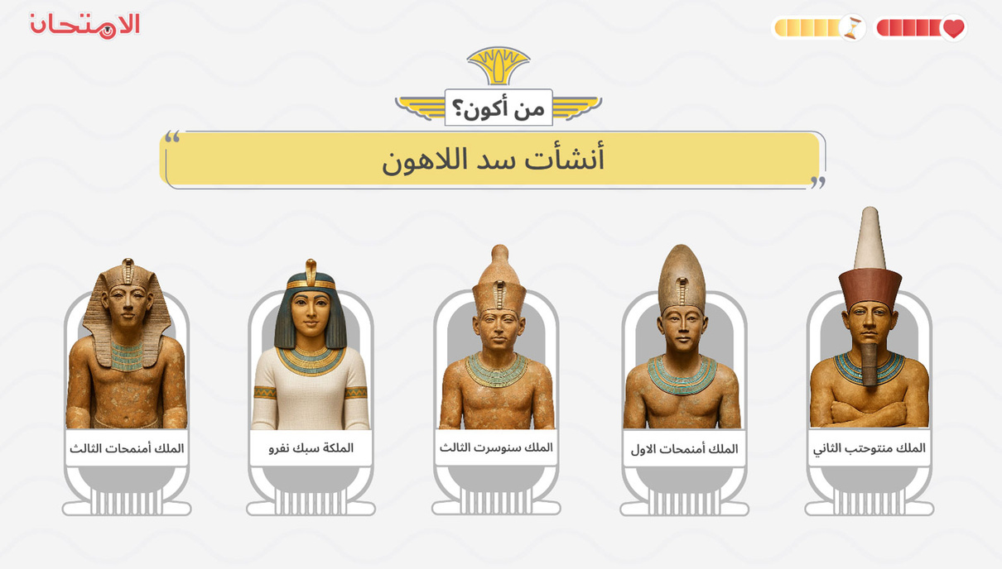
1: INTRODUCTION

Slide 4
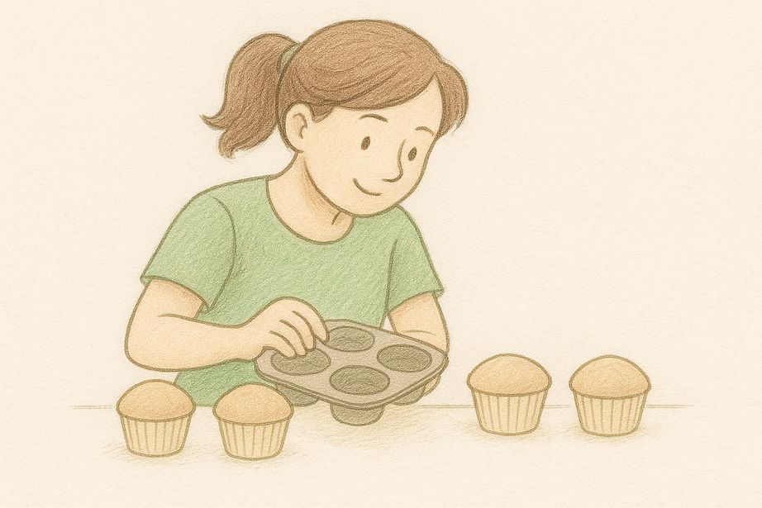
2- WHAT IS A TEMPLATE?
1
Reusable framework with different inputs
2
Consistent design, interaction & logic
3
Widely used by platforms like Genially

Slide 5
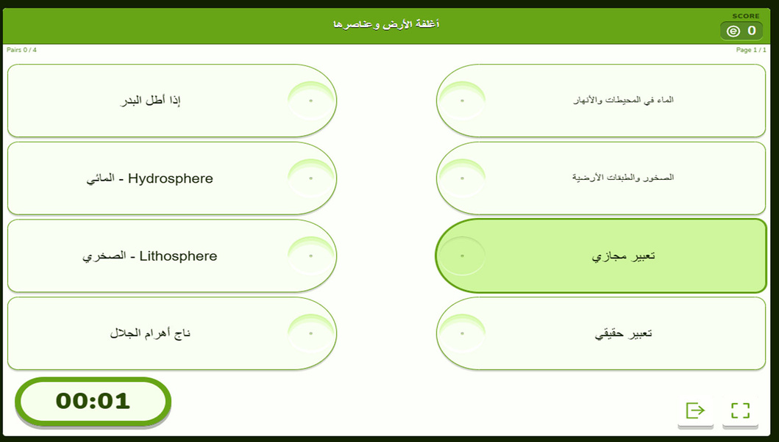
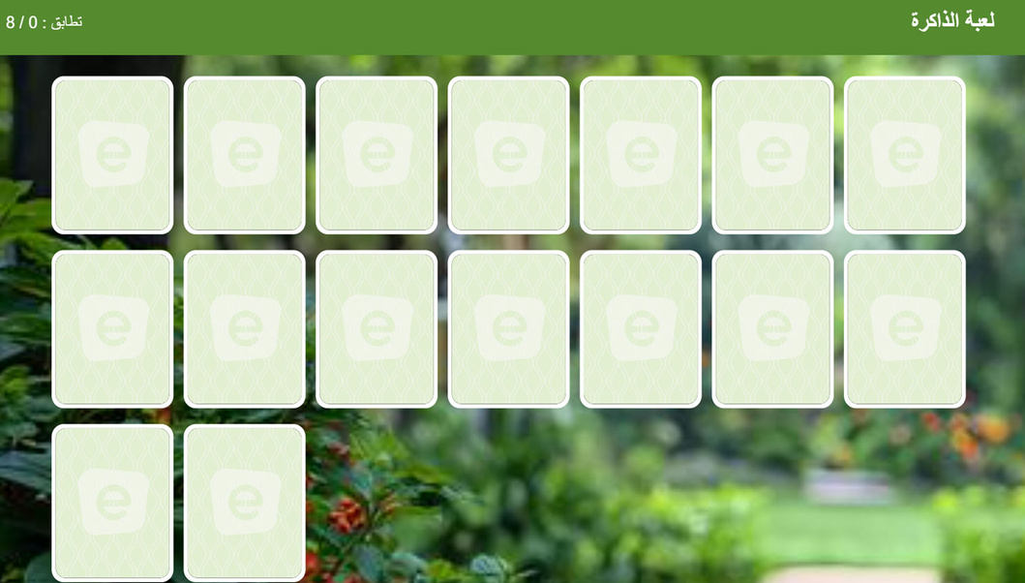
3-EXAMPLES

Slide 6
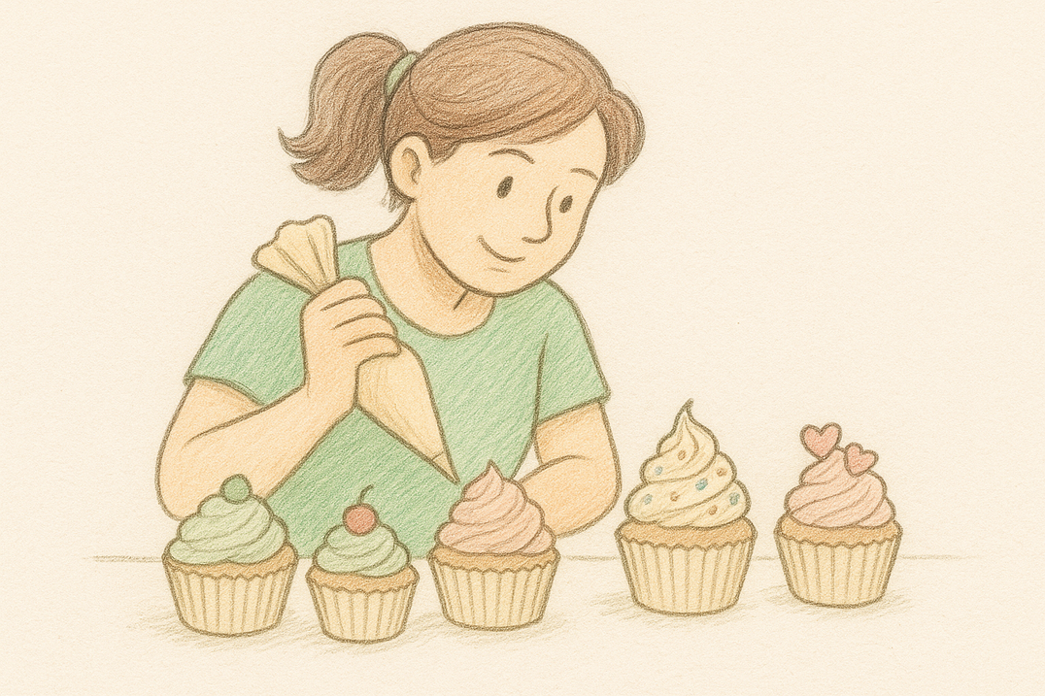
4-HOW TO USE TEMPLATES
Two Customizable Elements:
Design elements (colors, layout)
Content (text, images, data)

Slide 7
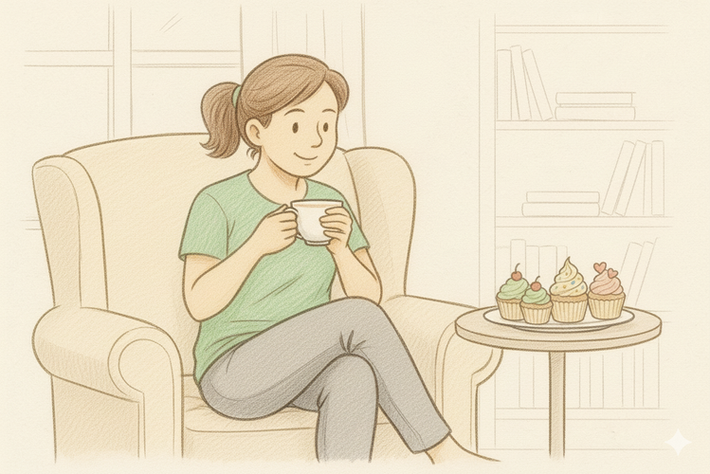
5-TEMPLATES ADVANTAGES
Time & Effort Savings
1
2
Consistent User Experience
3
Scale content production across subjects and grades
4
Easy Maintenance & Updates

Slide 8
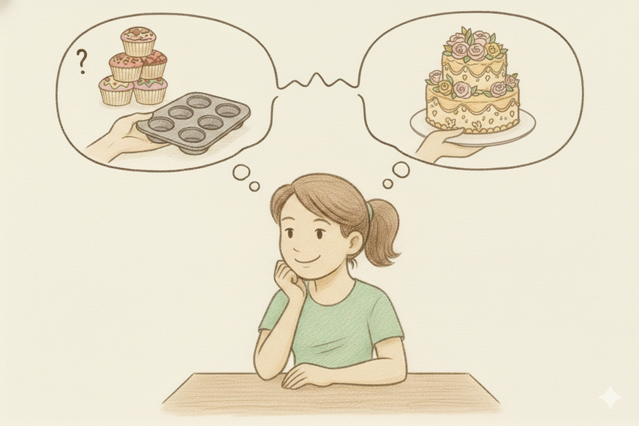
6- TEMPLATE MINDSET
1
Repeatable
3
Separable content from design
2
Standardized
Consistent interaction pattern
4

Slide 9
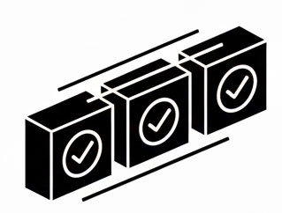
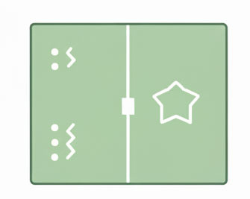
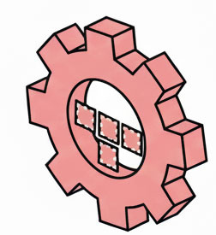
7- CREATING NEW TEMPLATES
1
2
3
Repeatable
Separable
Consistent

Slide 10
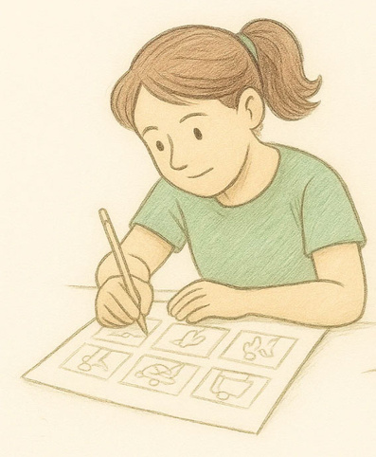
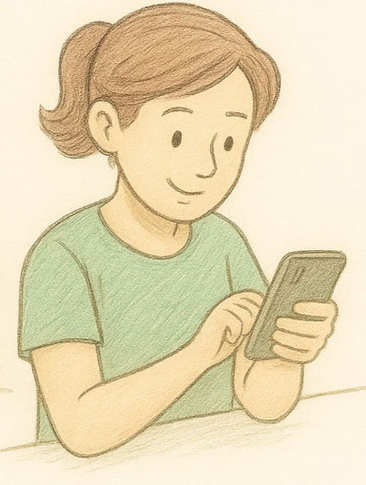

8- WHEN DO WE NEED STORYBOARD?
1
Brand New Template
1
Existing Templates
2
Complex or Multi-Path Templates
2
Minor Cosmetic Changes
3
Major Template Modifications
3
Simple, Clear-Cut Templates

Slide 11


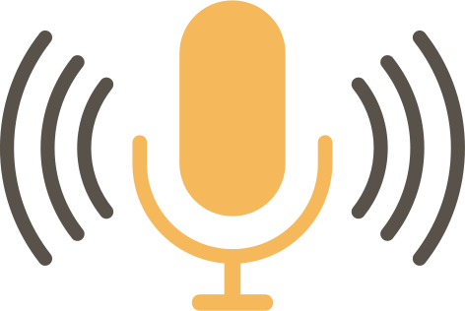
9- INPUT TYPES
1
2
3
text
text + img
V.O

Slide 12



